Slide 1
The Sky and Its Motion
Astro Pages14-18
Chapter 2-2

Slide 2
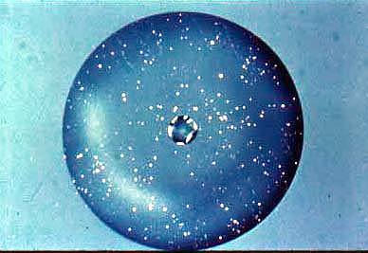
In order to learn how to understand the sky, we are required to see it from the perspective of the original astronomers 1000’s of years ago.

Slide 3
The Celestial Sphere
Ancient astronomers believed the Earth was surrounded by a great sphere (the sky), with the stars stuck on the inside (like thumbtacks in the ceiling).
We now know the stars are great distances away, not all the same distance from Earth.

Slide 4
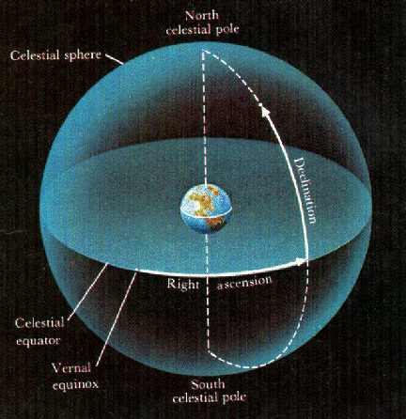
The original sphere model was called the Celestial Sphere.

Slide 5
Celestial Sphere – an imaginary sphere of very large radius surrounding Earth, to which the planets, stars, sun, and moon seem to be attached.
Scientific Model – a concept that helps you think about some aspects of nature without necessarily being true.

Slide 6
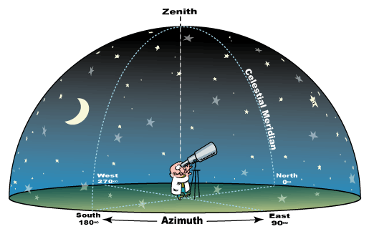

Slide 7
The celestial sphere model is a useful tool to use when discussing what we see from Earth’s perspective.
It gives us a framework, but is based on assumptions that we know to be false.

Slide 8
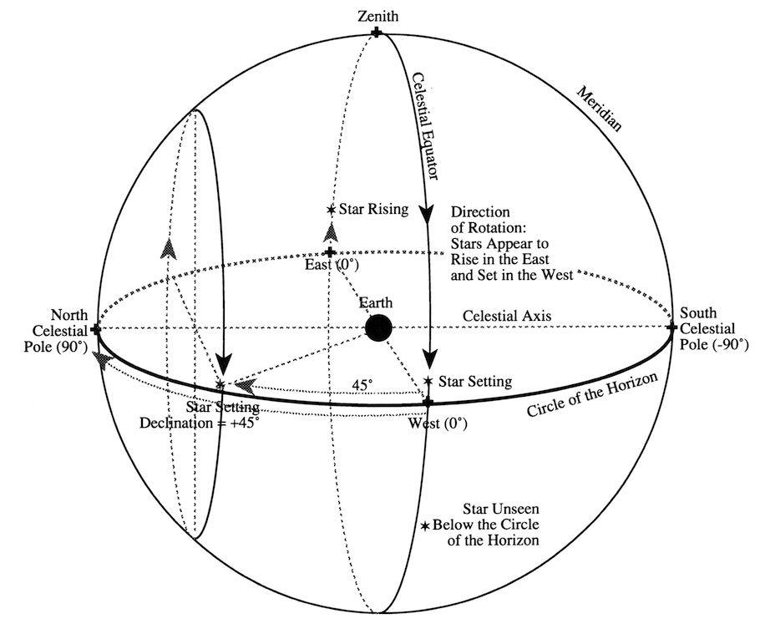
There are three (3) important ideas to remember when looking at how the sky moves and the celestial sphere model in general.

Slide 9
Sky objects appear to rotate westward around the Earth each day, due to the eastward rotation of Earth.
This rotation produces day and night as the
Earth rotates on its axis.
At any time you only see ½ the celestial
sphere, that is the part above the horizon.

Slide 10
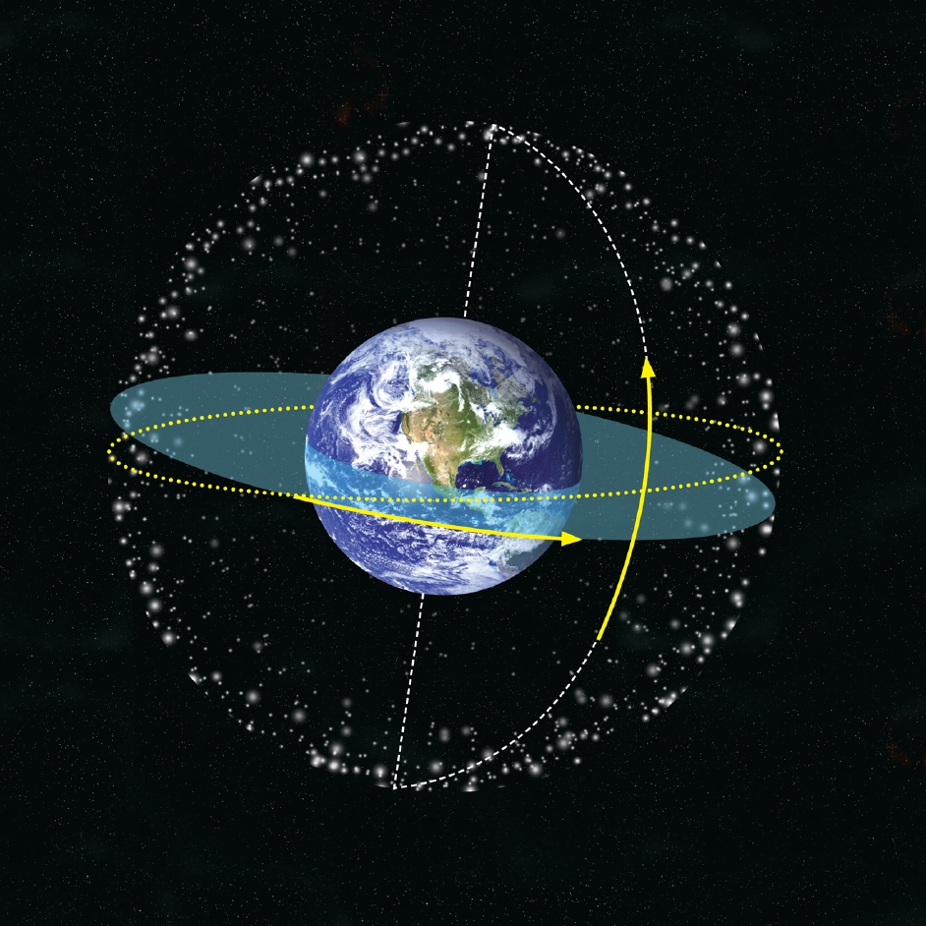

Slide 11
Vocabulary
Horizon – circular boundary between Earth and sky
Zenith – the point in the sky directly above the observer
Nadir – the point on the celestial sphere directly below the observer (opposite the zenith)

Slide 12
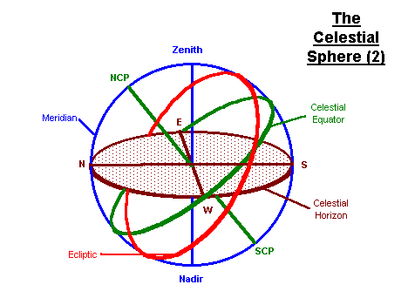

Slide 13
Vocabulary
Celestial North and South Poles – points in the sky directly above the Earth’s geographical North and South Poles.
Celestial Equator – the imaginary line around the sky directly above Earth’s equator

Slide 14
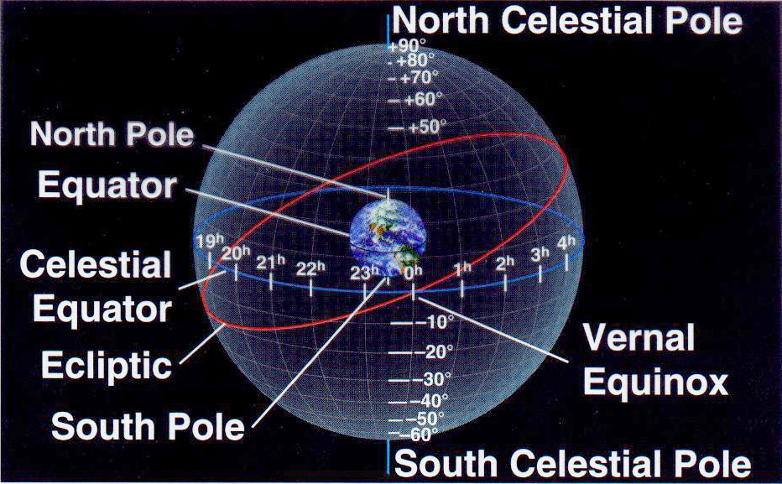

Slide 15
2. What you see in the sky depends on your
location (latitude) on Earth.
→ Northern vs. Southern hemisphere
→ Your zenith moves as you move, and it
may correspond to other points
depending on your location.

Slide 16
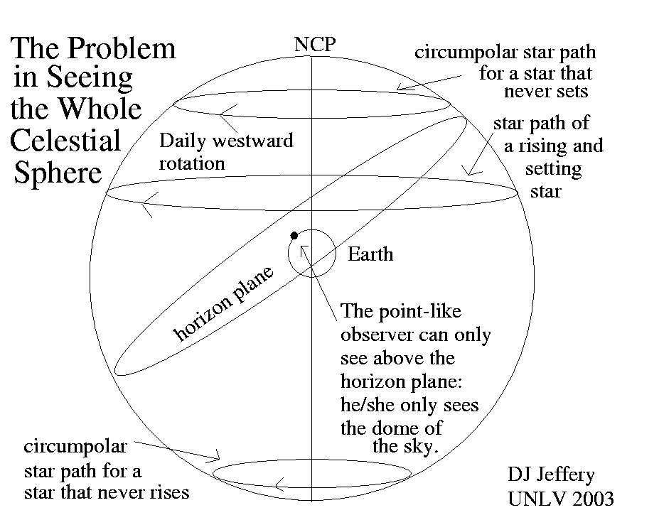

Slide 17
3. Astronomers measure distances across the sky in degrees and parts of degrees (minutes and seconds).
Circumpolar constellations never set because they rotate around the celestial pole, never dipping below the horizon
Still this too is based on your latitude as to how many constellations there would be
At equator there are no constellations that never set, and the number increases as you go toward the poles

Slide 18
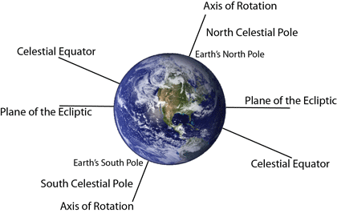
Precession
As the Earth rotates on its axis, that axis is tilted from the vertical
The tilt of the axis continues to change in 3-D space, and is called precession.

Slide 19
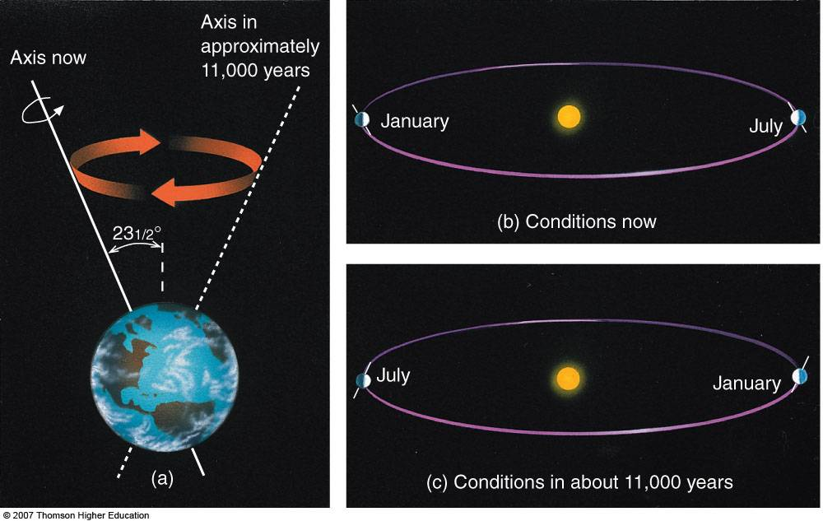
Precession – the slow change in orientation of the Earth’s axis of rotation

Slide 20
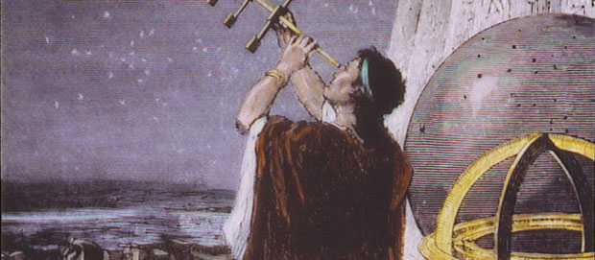
The astronomer Hipparchus first noticed the Earth’s axis had changed direction, by comparing his findings on locations of stars to their noted locations 200 years previous.
He realized that the rotational poles and equator were slowly moving relative to the stars.

Slide 21
Like a spinning top, as the toy spins its axis sweeps in circles.
The Earth behaves in the same manner as it spins once each day, and would theoretically make one “sweep” around the circle in about 26,000 years.

Slide 22
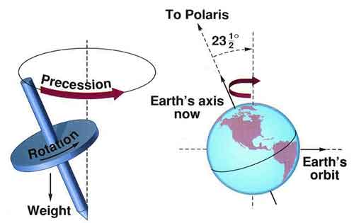

Slide 23
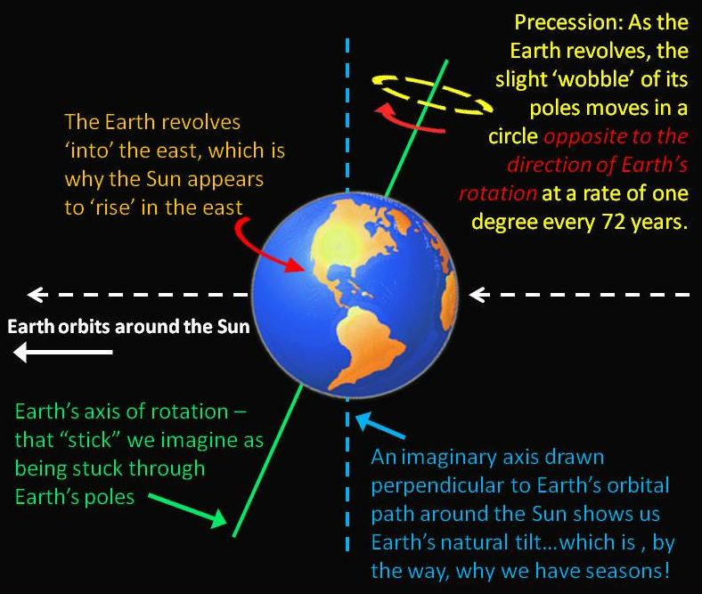
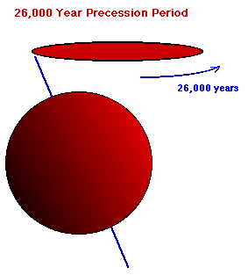
Earth’s tilt is 23.5º from vertical, spinning at an angle due to its mass not being evenly distributed with the equator bulging outward.

Slide 24
For example, the precession of the Earth has changed our “pole star” through recorded history.
→ 4800 years ago, the Egyptians noted the
pole star was Thuban, in the constellation Draco.
→ Currently our pole star is Polaris, in the
constellation Ursa Minor.
→ In about 12,000 years, our pole star will
theoretically be Vega, in the constellation Lyra

Slide 25
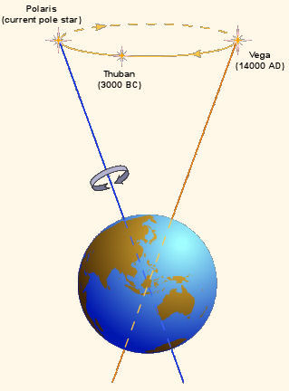
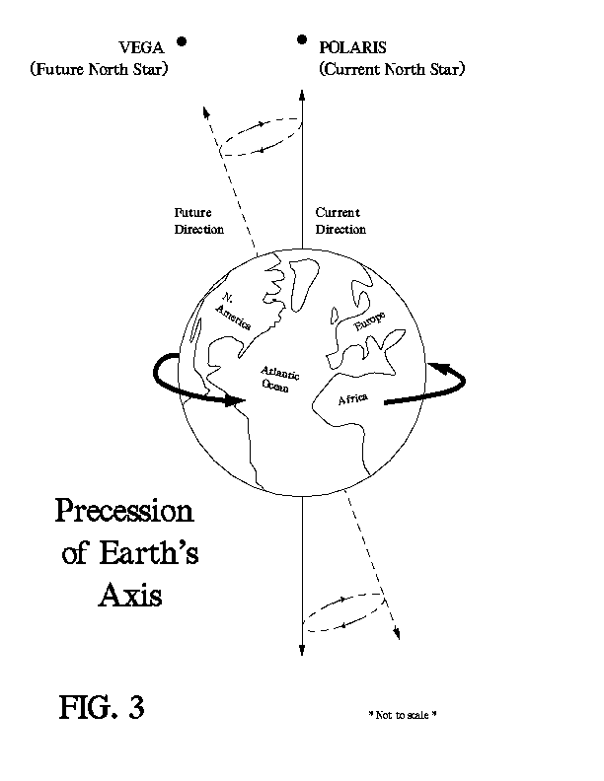

Slide 26
